Slide 1
Cross Product
(Not to be confused with crossfit)

Slide 2
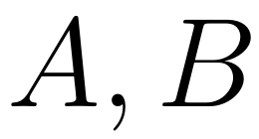
Another way to make new sets from old!
For sets:

Slide 3
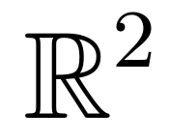
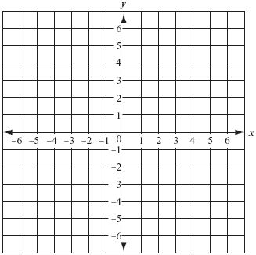
Familiar Example:
(3,4)

Slide 4
Fun Example:
(
)
(
)
(
)
(
)
(
)
(
)

Slide 5
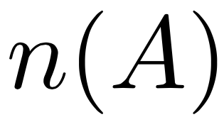
Counting Cross Products:
So what is
(
)

Slide 6
(
)
(
)
(
)
(
)
(
)
(
)
(
)
2
3
6

Slide 7
Group Work: (making them…)

Slide 8
Group Work: (counting them…)
(
)

